Slide 1
Team Seats
S
C
R
E
E
N
10
TA
1
2
3
9
13
4
5
6
8
12
7
11

Slide 2
Checkpoint # 1 Raspberry Pi and ROS
Mobile Robot
Fall, 2020

Slide 3
Outline
Team Seats
Materials Check
Checkpoint #1
Environment Setting
ROS
Lab632 opening hours
Note
--------------------------------
Every team has one PC and one Material Box

Slide 4
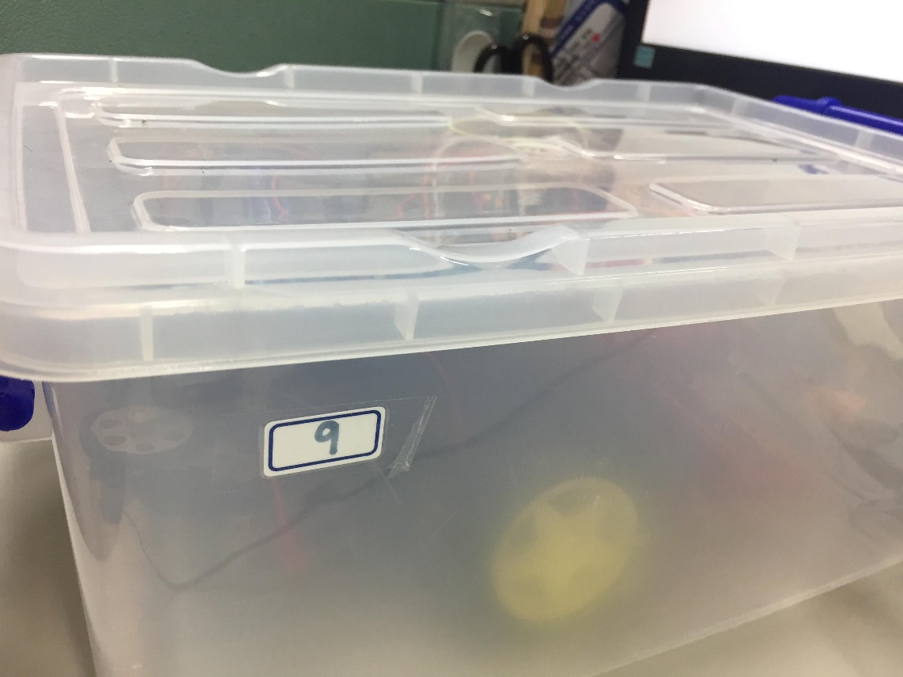
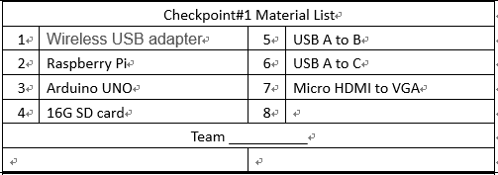
Materials Check

Slide 5
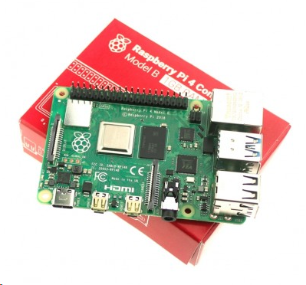
Checkpoint#1
Purpose: setting the development environment for robot and using ROS system.
Task1: Setting up the environment and remote control the RPi
Install Ubuntu mate 18.04 in Raspberry Pi
Install ROS Melodic in Raspberry Pi
Using the Raspberry Pi by remote control it
Task2: Using ROS to communicate
Communicate between Raspberry Pi and Arduino by using ROS
ROS

Slide 6
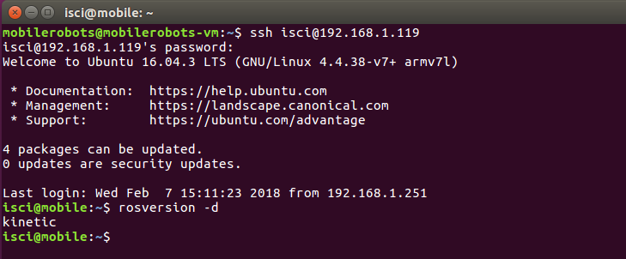
Checkpoint#1 – Task 1

Slide 7
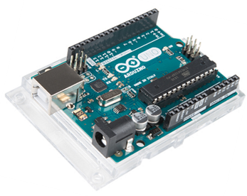
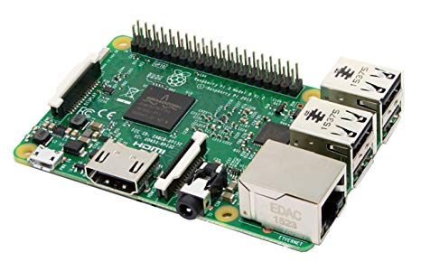
Checkpoint#1 – Task 2
Publish a topic
(a number)
Subscribe the topic
(the number)
RPi
Arduino
1 | 2
3 | 4
RPi
Arduino
Multiply the number by 2
Make it as a new topic
Subscribe the new topic
Publish the new topic
Arduino
RPi
Arduino

Slide 8
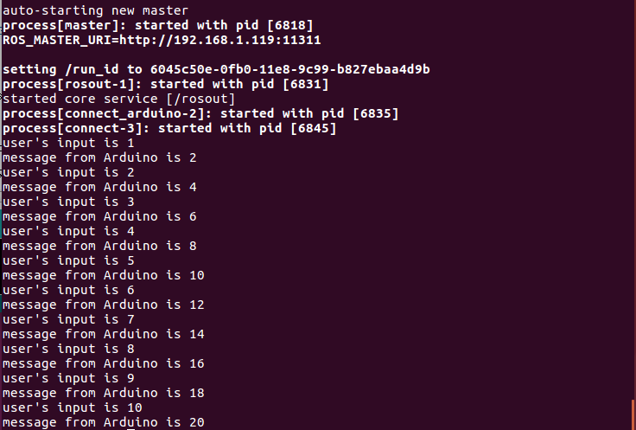
Checkpoint#1 – Task 2

Slide 9
Environment Setting
Wifi
------------------------------------------------------------------------------------
Wifi-1
EE-assistive
pwd: assistive
Wifi2
EE-assistive_5G-1
pwd: assistive
PC setup
RPI Install Ubuntu mate 18.04
Install ROS Melodic
Remote Control Setting

Slide 10
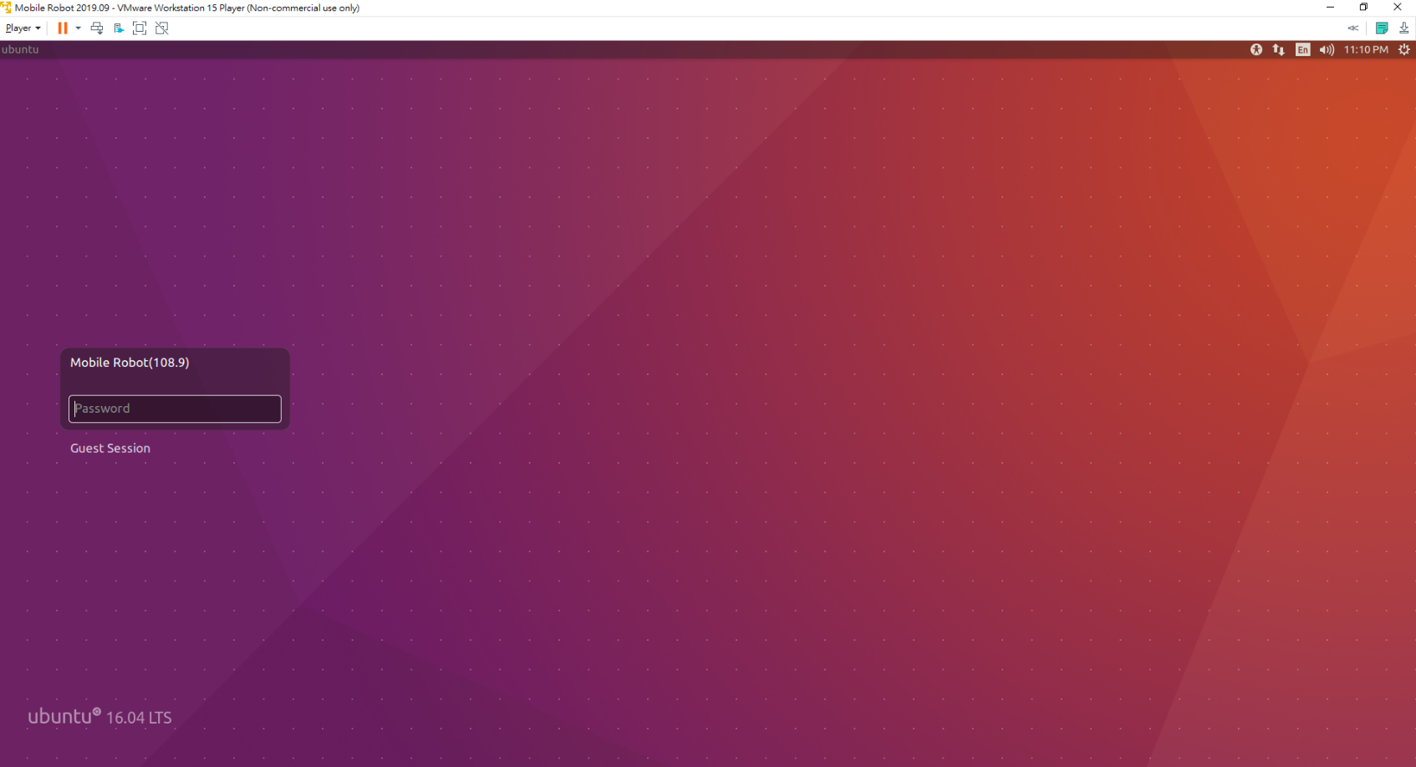
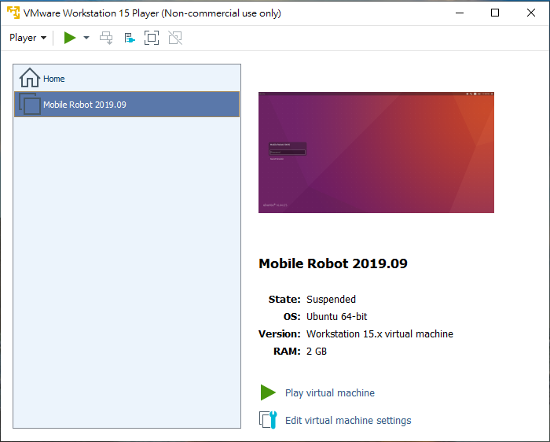
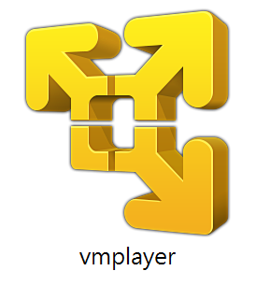
VMware – Ubuntu 18.04
Mobile Robot 2020.09
pwd: lab632

Slide 11
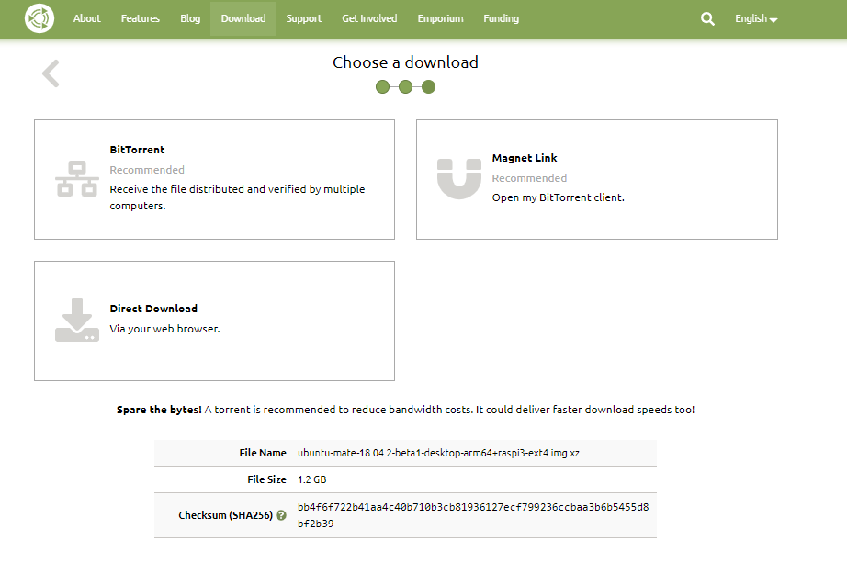
Install Ubuntu mate 18.04
Download Ubuntu mate 18.04 from https://ubuntu-mate.org/download/
Note
--------------------------------------------------
Ubuntu-18.04.5-desktop-amd64.iso
ubuntu-mate-18.04.2-beta1-desktop-arm64+raspi3-ext4.img.xz

Slide 12
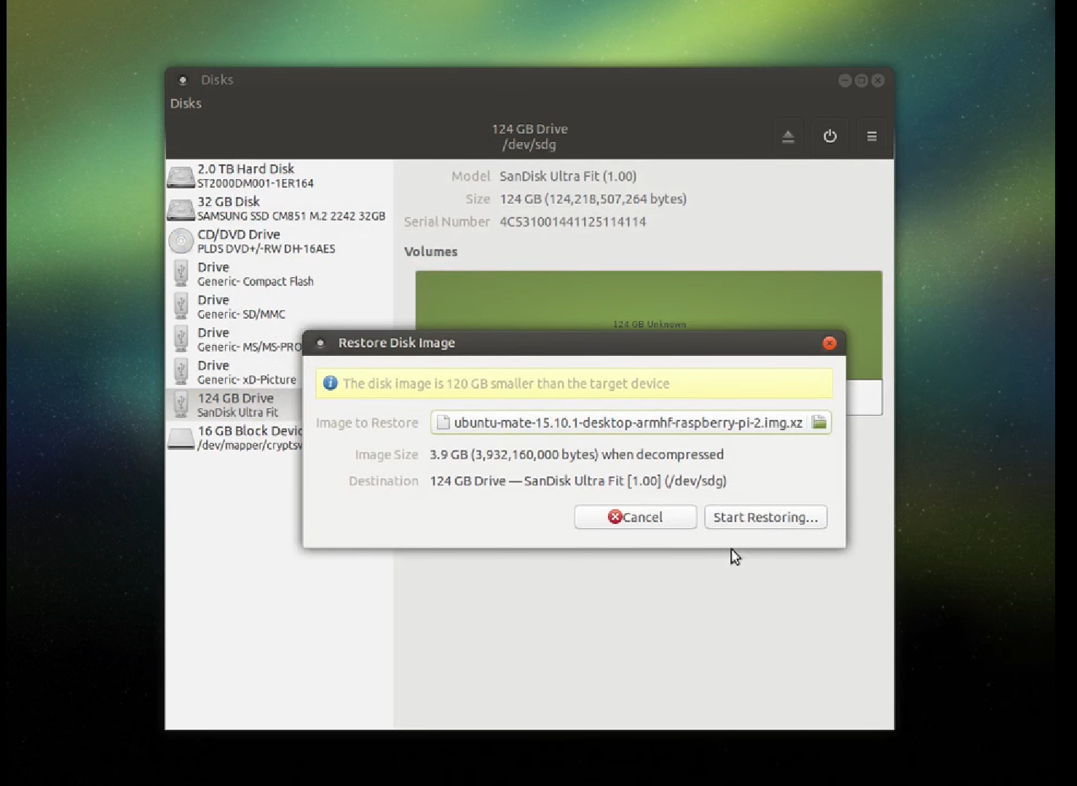
Install Ubuntu mate 16.04
Make image SD card by using GNOME Disk
Tools
-----------------------------------------------------------
Linux: GNOME Disk
Windows: Win32 Disk Imager

Slide 13
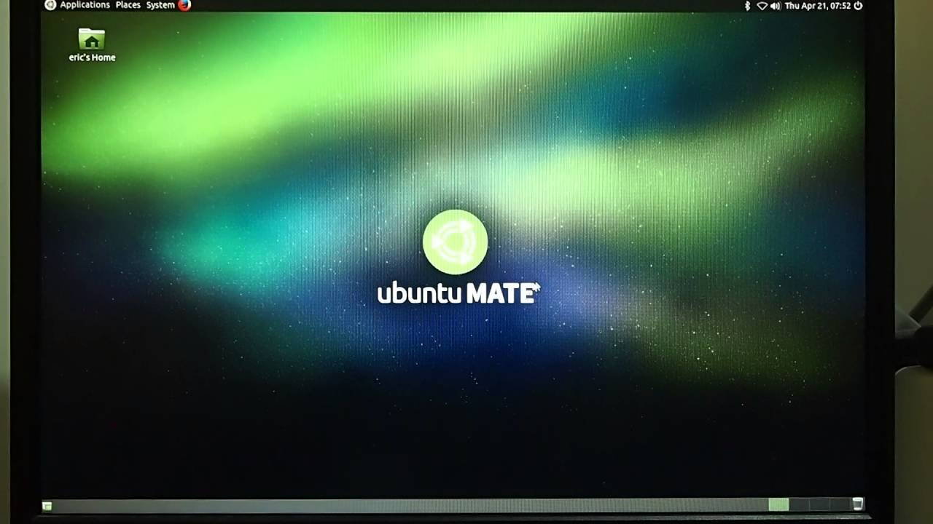
Setting Raspberry Pi

Slide 14
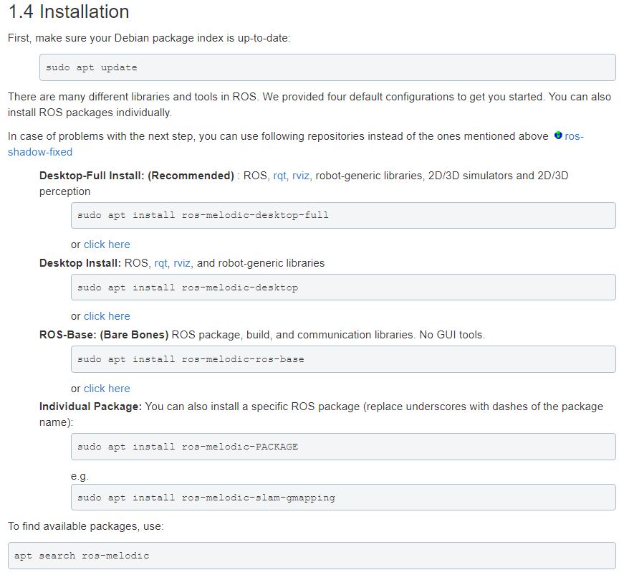
Install ROS Melodic
http://wiki.ros.org/melodic/Installation/Ubuntu
1.2 Setup your sources.list
1.3 Set up your keys
1.4 Installation
1.5 Initialize rosdep
1.6 Environment setup
1.7 Dependencies for building packages
PC
RPI

Slide 15
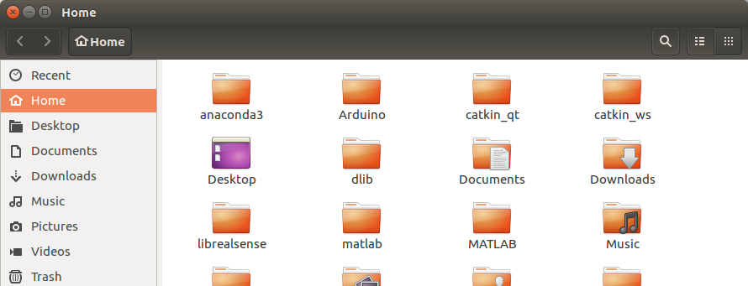
Create ROS Workspace
A catkin workspace is a folder where you modify, build, and install catkin packages.
Follow the step from “Create a ROS Workspace” guide
http://wiki.ros.org/ROS/Tutorials/InstallingandConfiguringROSEnvironment

Slide 16
Setting ssh between RPi and PC
Install ssh in both PC and Paspberry Pi
Find Rpi’s address, netmask and gateway for setting the static ip
Using ssh to remote connect with PC

Slide 17
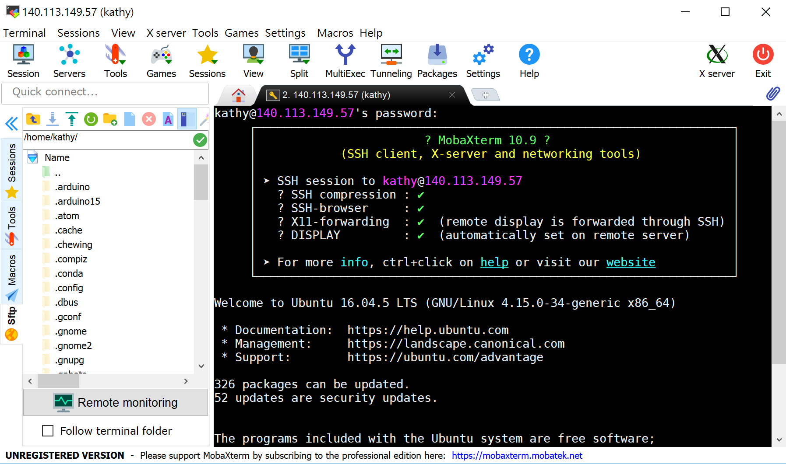
Tools for remote control
ssh in terminal
VNC Viewer
(recommend) MobaXterm

Slide 18
Introduction to ROS
Introduction to ROS
ROS file system level
ROS computation graph level
Publisher & Subscriber
Note
------------------------------------------------------------------------------------------------------
Site: http://www.ros.org/
Documentation: http://wiki.ros.org/
Reference: Mastering ROS for Robotics Programming

Slide 19
Introduction to ROS
ROS (Robot Operating System) is an open-source, meta-operating system for robot.
Features
Code reuse (exec. nodes, grouped in packages)
Distributed, modular design (scalable)
Language independent (C++, Python, …)
Easy testing (ready-to-use)
Vibrant community & collaborative environment

Slide 20
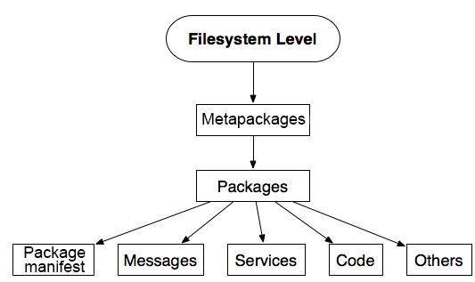
ROS file system level
Notes:
Packages are the main unit in ROS.
A package may contain nodes, a ROS-dependent library, datasets, configuration files, or anything else that is usefully organized together.
Packages are the most atomic build item and release item in ROS. Meaning that the most granular thing you can build and release is a package.

Slide 21
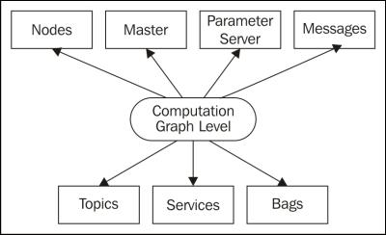
ROS computation graph level
Nodes
Master
Topics
Messages

Slide 22
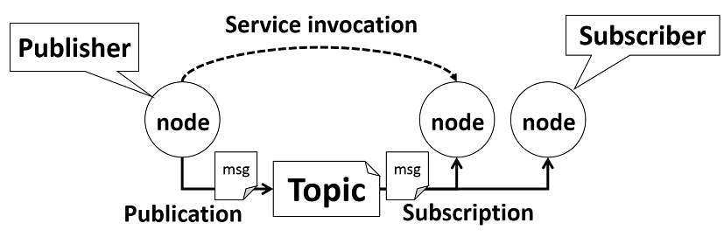
ROS nodes communication

Slide 23
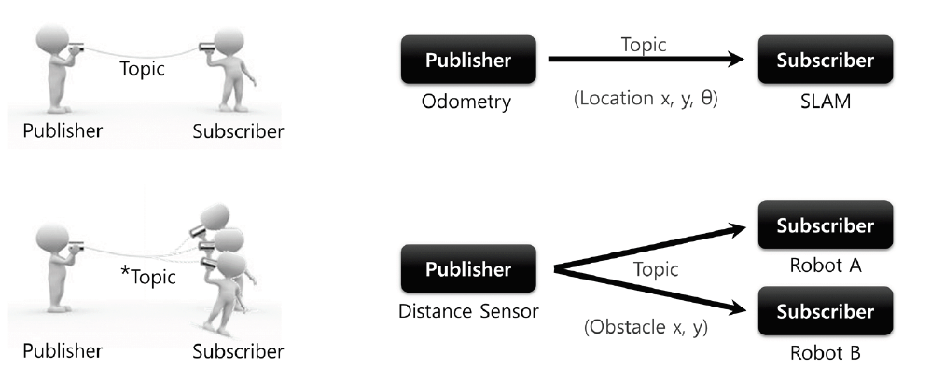
ROS nodes communication

Slide 24
Lab632 opening hours
Every Tuesday afternoon 15:30 to 18:20 and Wednesday night 6:30 to 9:20 lab632 will open for everyone to practice.
Deadline
--------------------------------------------------------
Checkpoint#1 Demo : 10/16
Checkpoint #1 Report : 10/23

